Slide 1
Artificial Intelligence
Final project
Jinhao Chen, German Ruiz, Georgy Loriya

Slide 2
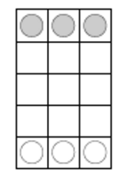
Overview
3x5 Pawn Game
Design of the game
Algorithm to choose
Test the game
Summary

Slide 3
Pawn Game 3x5
-Board size is 3 by 5
-White pawns go first
-Win if you reach the end of the board or
-Win if all the opponent’s pawns are blocked

Slide 4
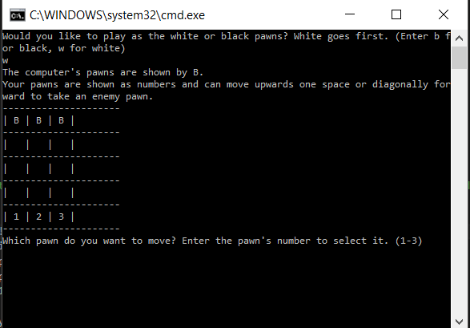
Design of the game
2D array for the board
1D array for location of pawns
Functions
Limited depth Minimax

Slide 5
Limited depth minimax algorithm
-Great results for zero sum games
-Complicated functions for heuristics
-Depth of 6 is reasonable and effective
-Challenging hardness level

Slide 6
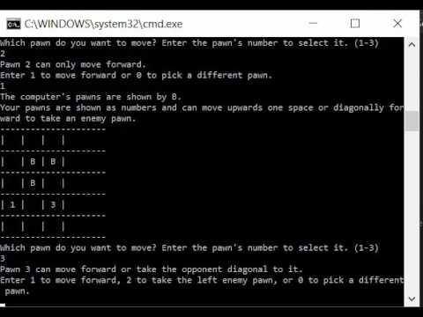
Example of gameplay
One of the few ways to defeat the AI.

Slide 7
Future Improvements
-Combine the 2D array for the board and 1D array for the pawn locations
-Better heuristic function (Less complex, more definitive)
-Better User Interface (Select and move pawn with arrows to available positions, hit enter to confirm move, watch PC move in slow motion)

Slide 8
Summary
-Implemented minimax algorithm into Pawn game
-Learned and implemented various AI concepts

